Slide 1
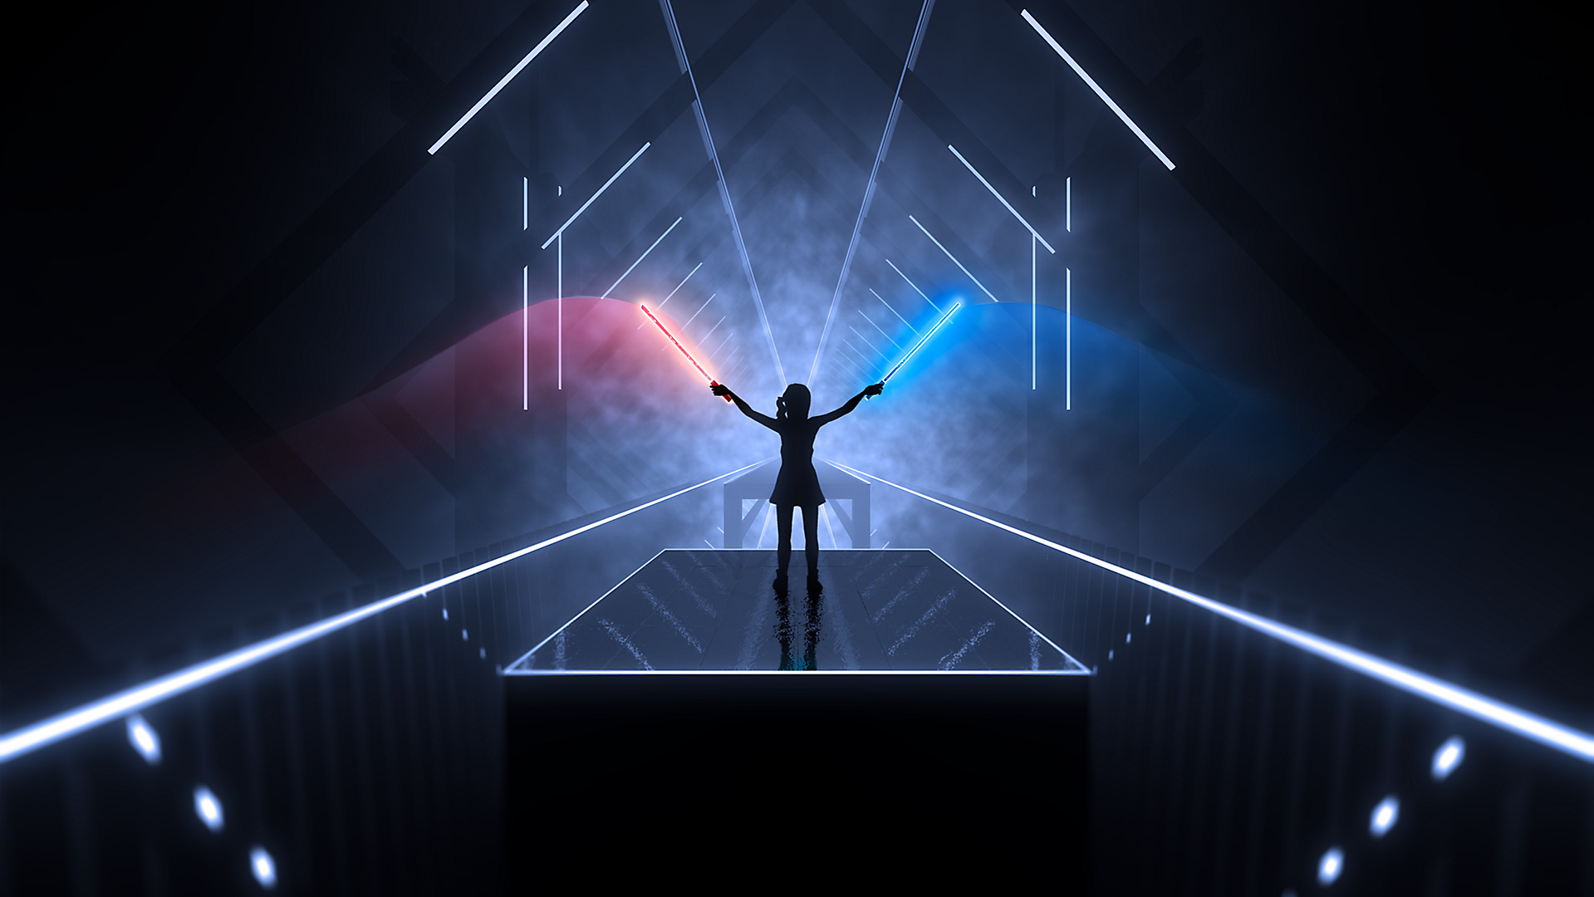
TEAM PANDEMONIUM
JACK GOBLE
THAI DO
ZUBE MOLOKWU
LEVI SHIRLEY

Slide 2

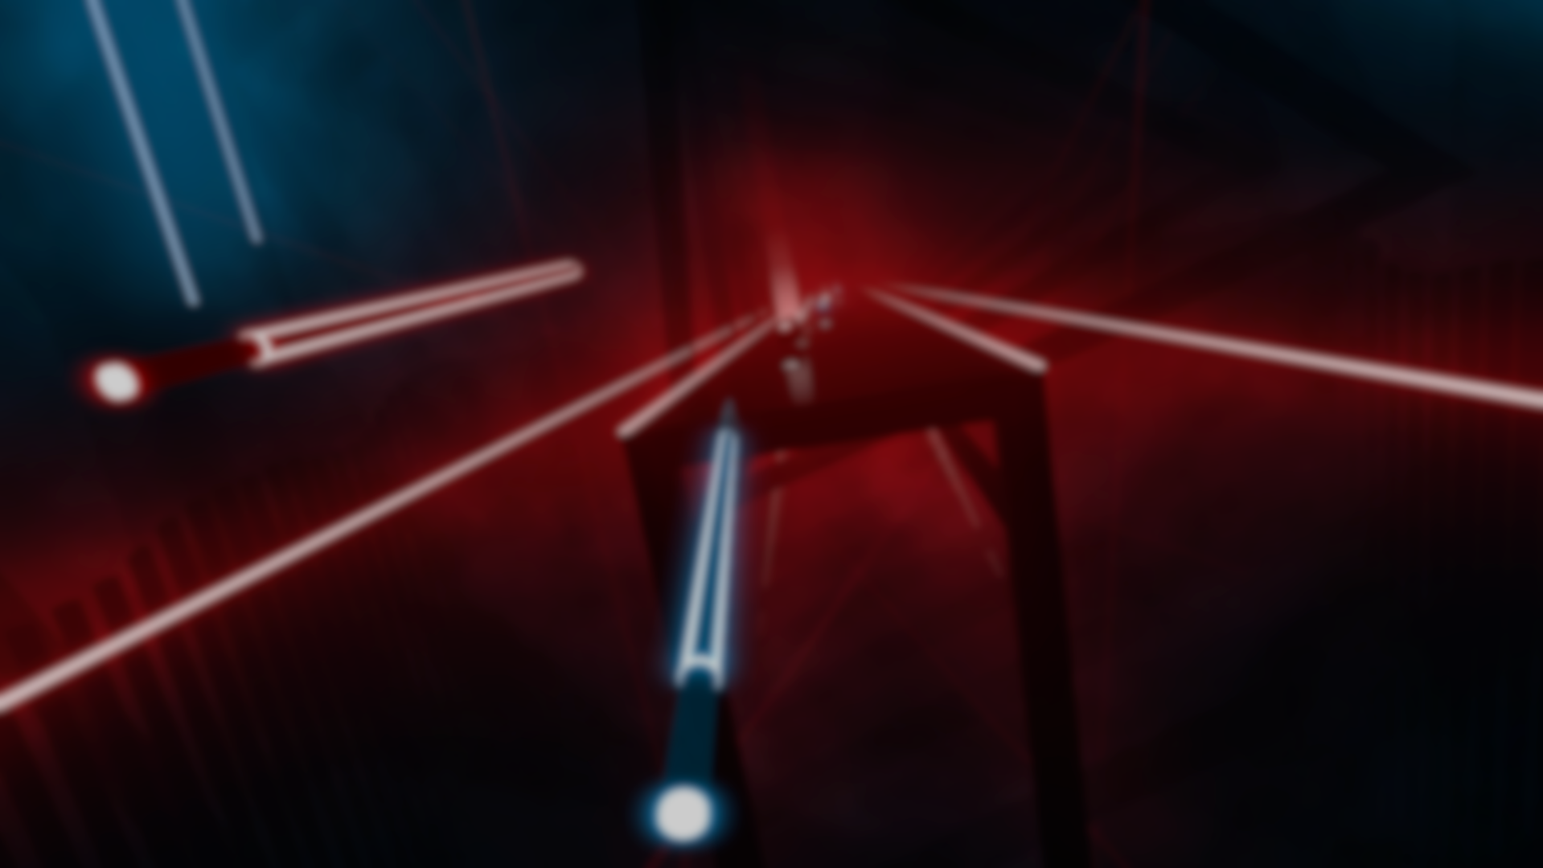
BEAT SABER
Beat Saber is a virtual reality rhythm game.
The goal of the players is to slash the incoming notes, and dodge potential obstacles such as bombs and walls.
When you slash a note, you have to slash it with the saber of the same color, and the direction of the slash has to be in the direction that the note specifies.

Slide 3
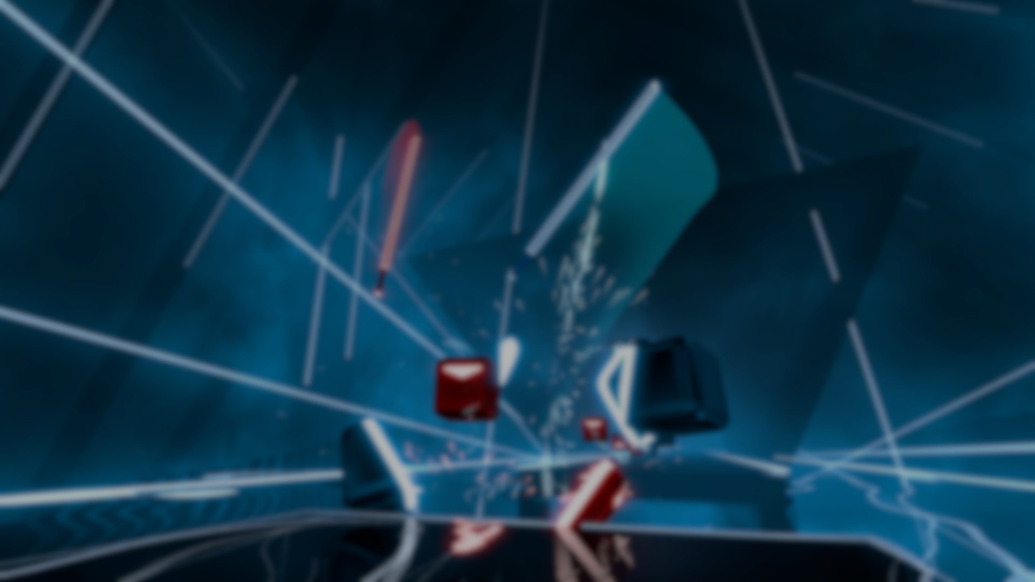
BEAT-MAPS
A beat-map is the level for a song that a player can play
A beat-map can have different difficulties: Easy, Normal, Hard, Expert, Expert+
Anyone can make a beat-map for any song, and share that beat-map with other players
A beat-map is a 3x4 grid, so a note, bomb, or wall can be placed within any of these 12 spots at any moment in time.

Slide 4
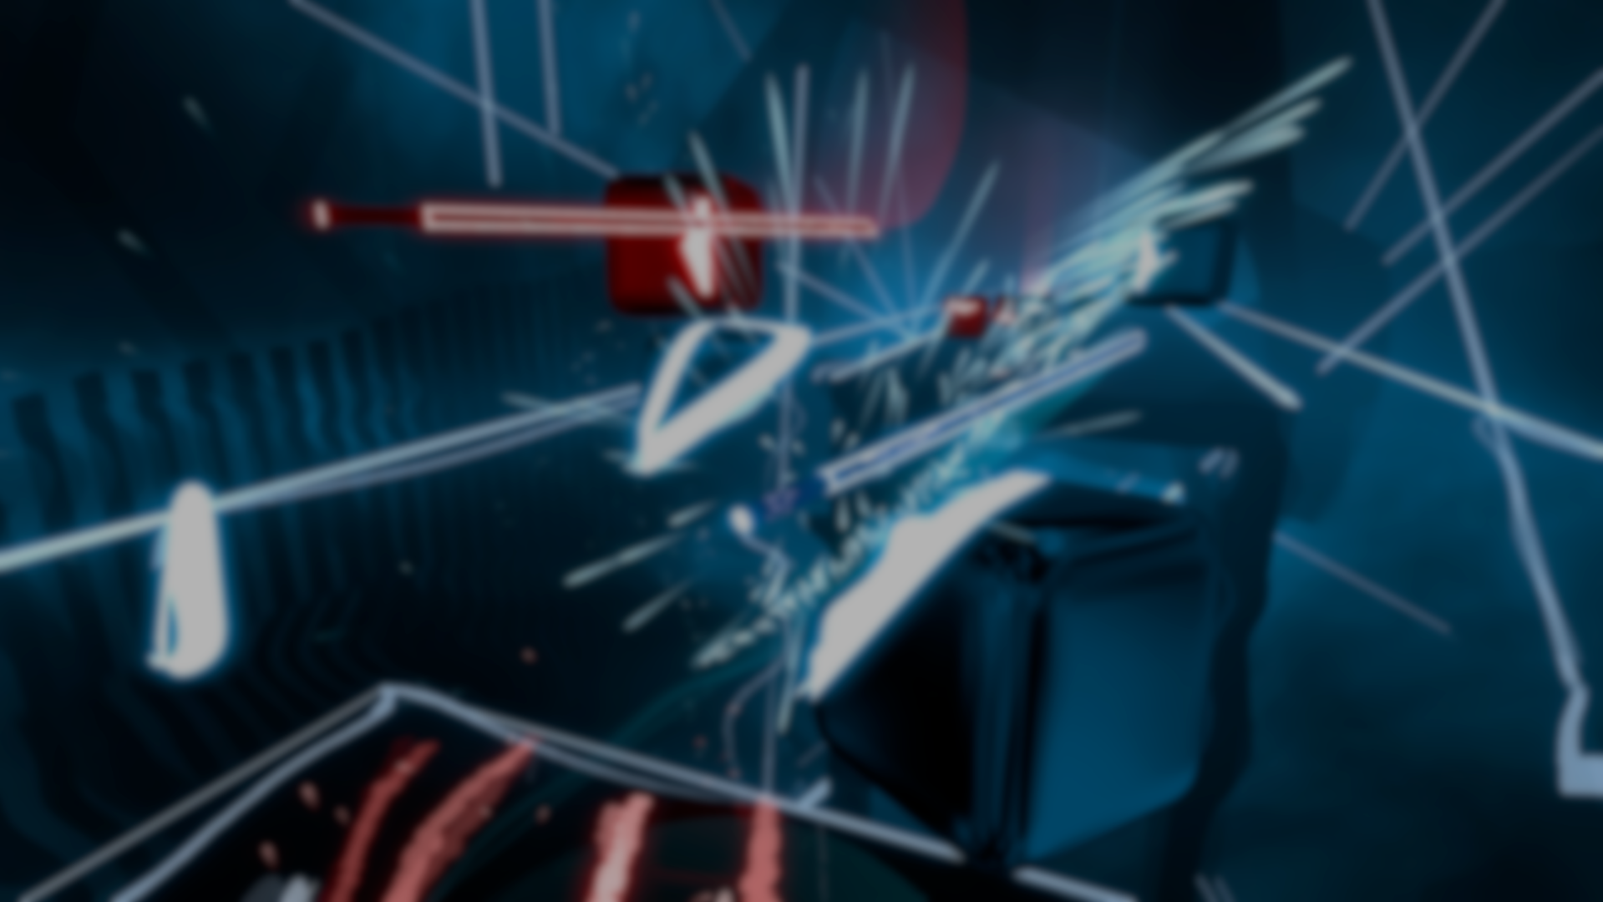
Goal of the Project
Because anyone can make a beat-map, there is an inconsistency among the shared maps.
Some maps that are shared online are impossible to play
Because of this, we wanted to build a neural network that is capable of automatically generating beat-maps given a song.

Slide 5
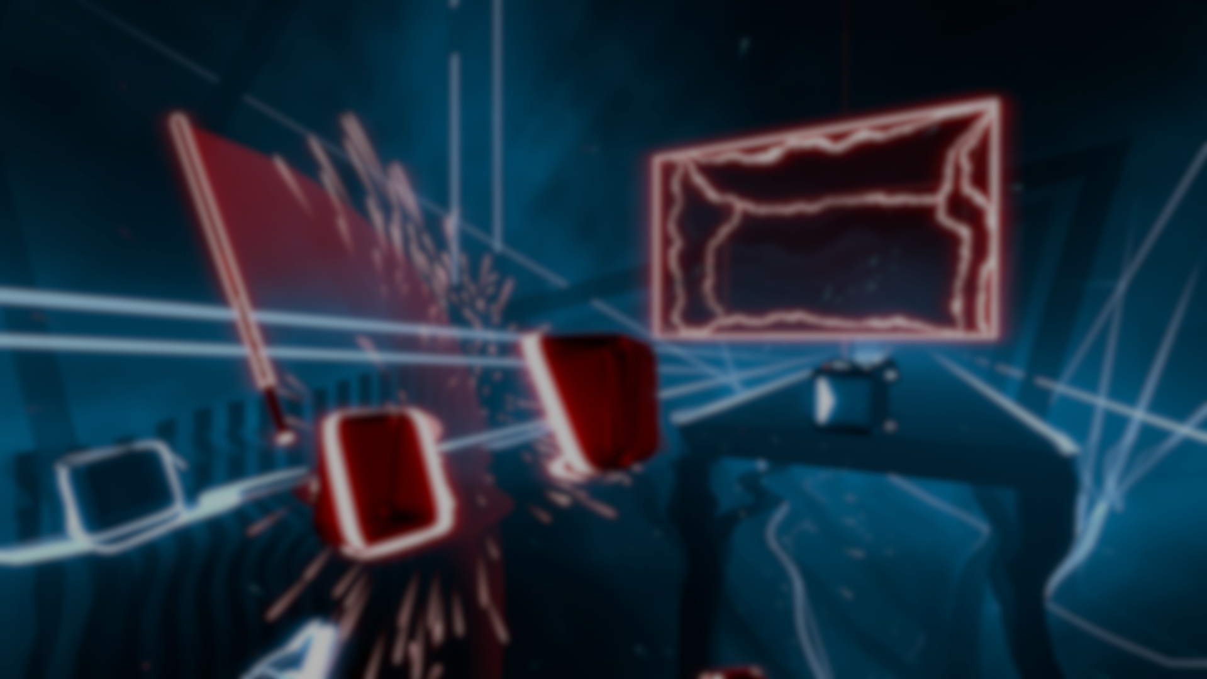
Audio File Processing

Slide 6

P.C.A.

Slide 7

Convolution Layer

Slide 8

LSTM Layer

